Slide 1


Blended intensive programme – Introduction to OpenSim
Basilio Goncalves & Hans Kainz

Slide 2
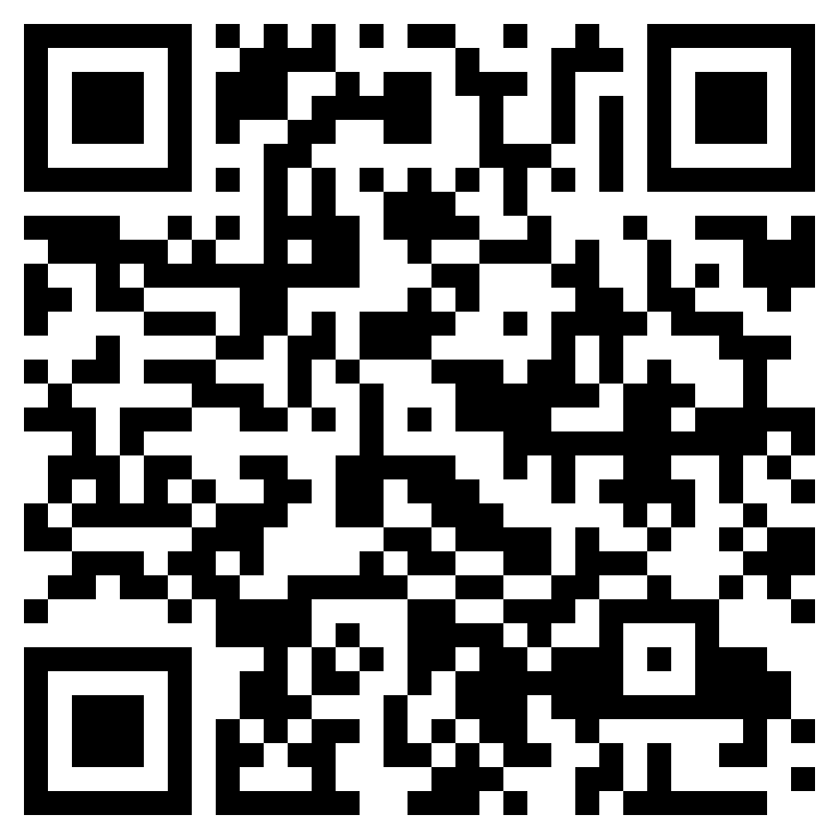
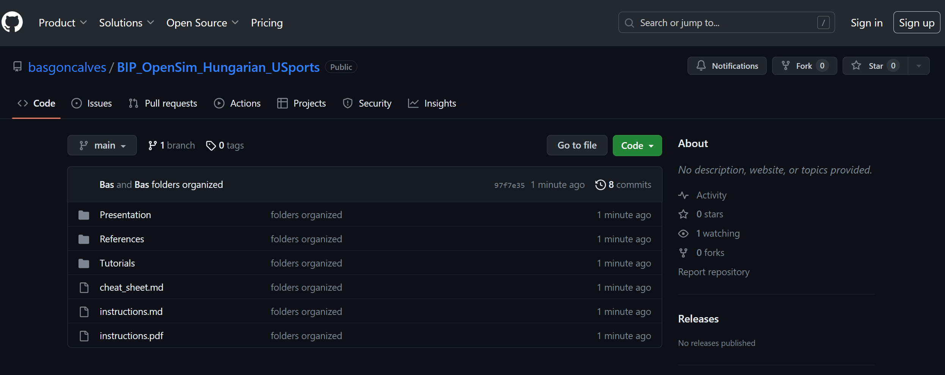
https://github.com/basgoncalves/BIP_OpenSim_Hungarian_USports
Notes:
https://github.com/basgoncalves/BIP_OpenSim_Hungarian_USports

Slide 3
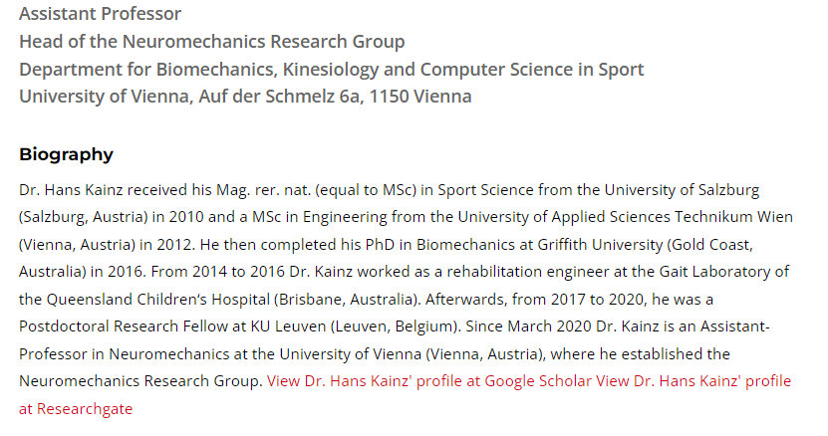
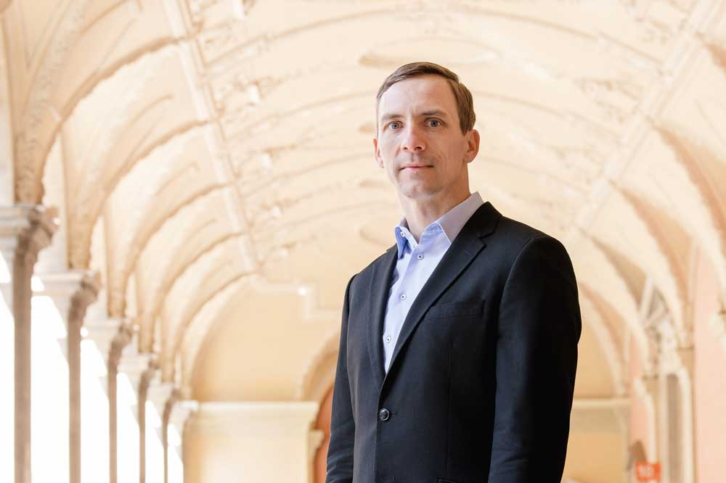
Hans
Who are we?

Slide 4
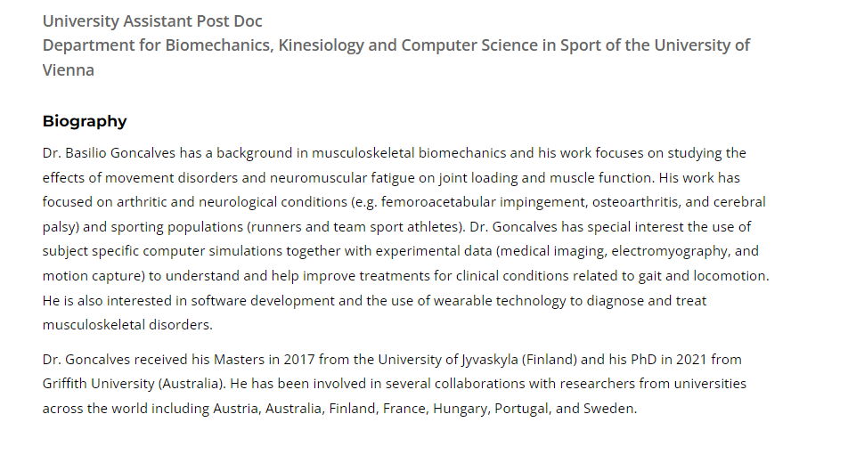

Bas
Who are we?

Slide 5
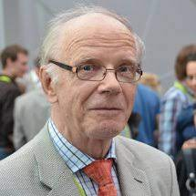
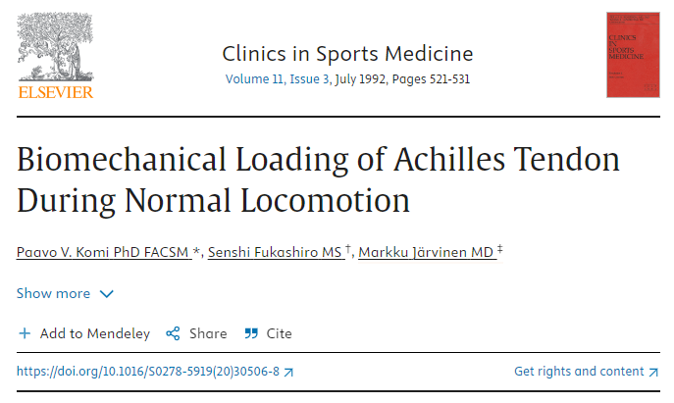
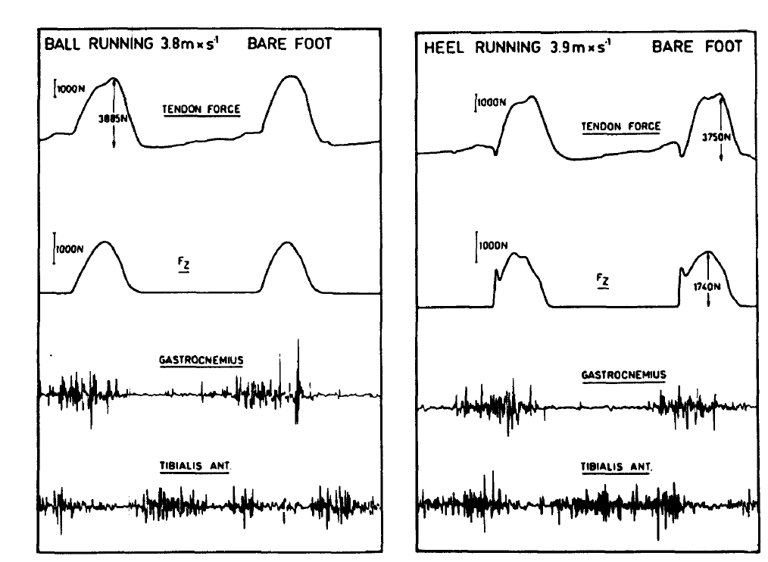
Why do we care?
Notes:
https://www.sciencedirect.com/science/article/abs/pii/S0278591920305068

Slide 6
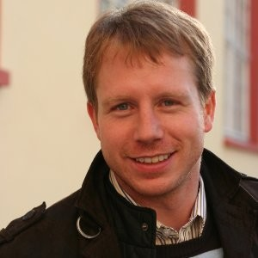
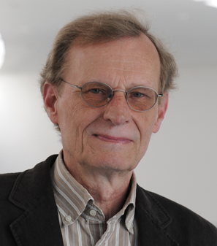
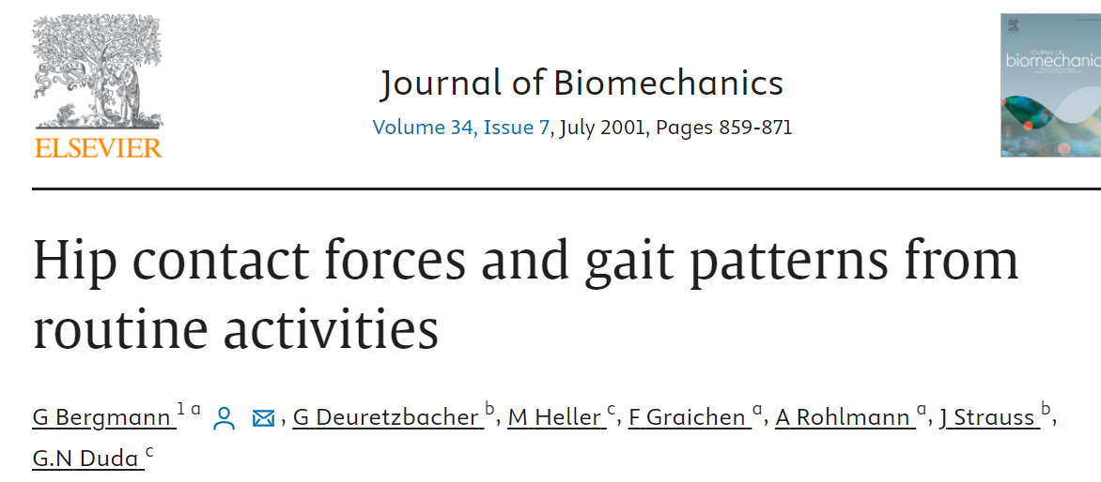
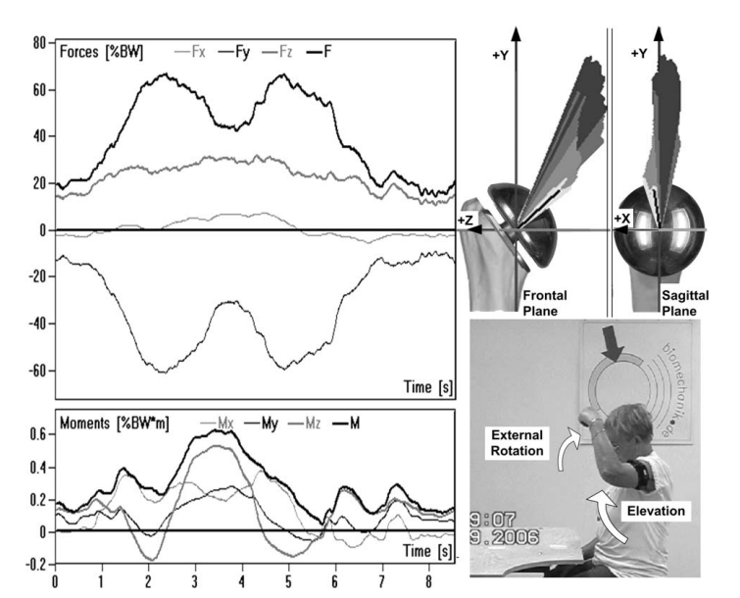
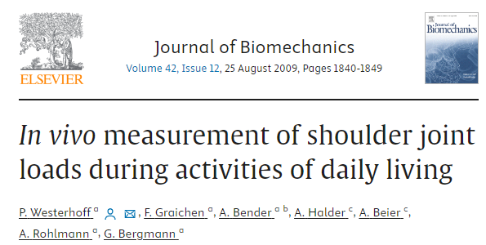
Why do we care?
Notes:
https://www.sciencedirect.com/science/article/abs/pii/S0021929009003169?via%3Dihub
https://www.sciencedirect.com/science/article/abs/pii/S0021929001000409?via%3Dihub

Slide 7
Main problems with in-vivo measurements
Why do we care?
Invasive
Cannot measure more than one muscle group
May alter individuals movement patters

Slide 8


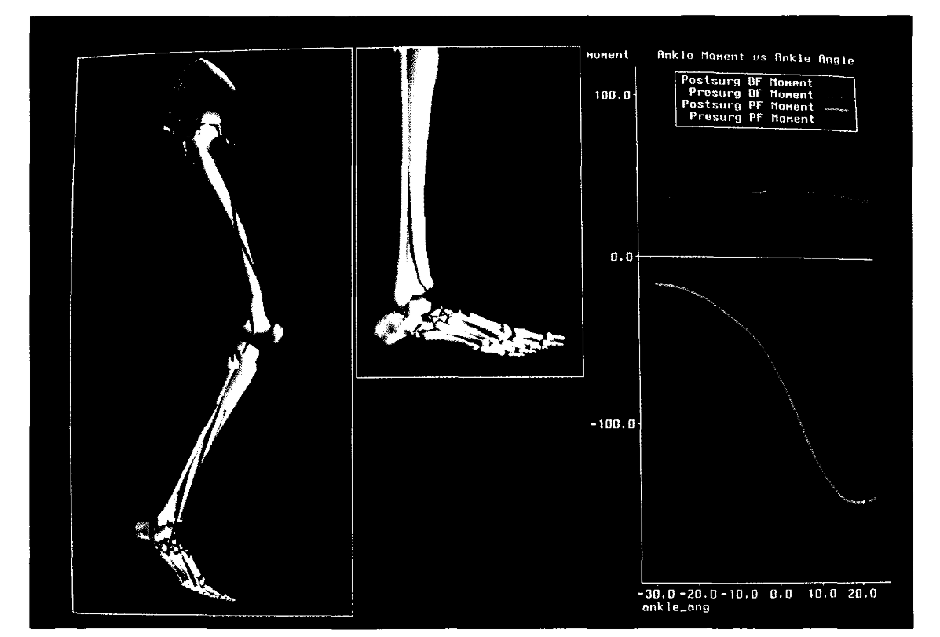
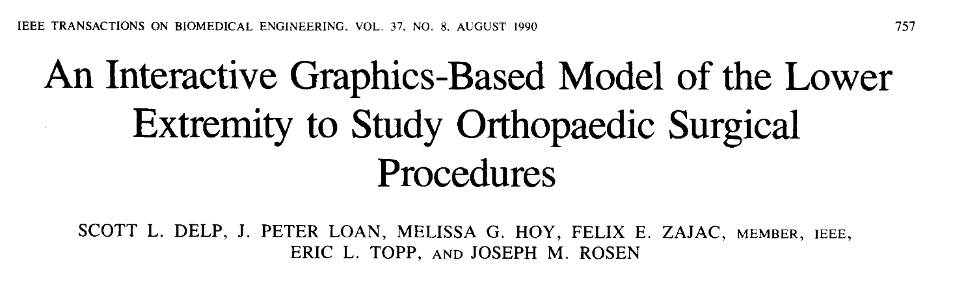
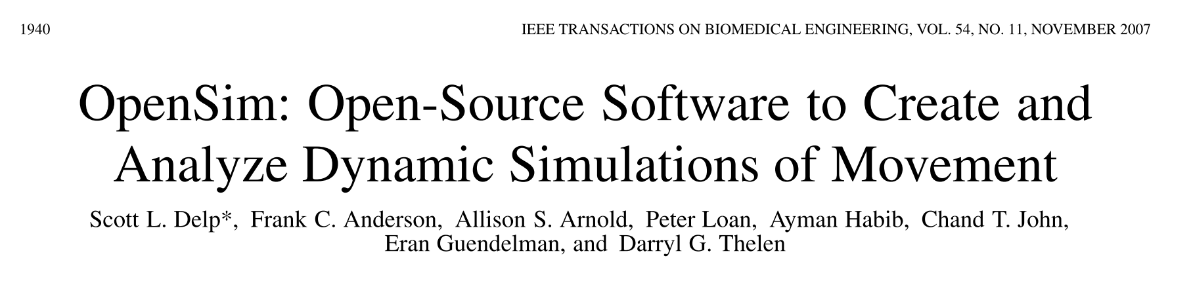

Slide 9
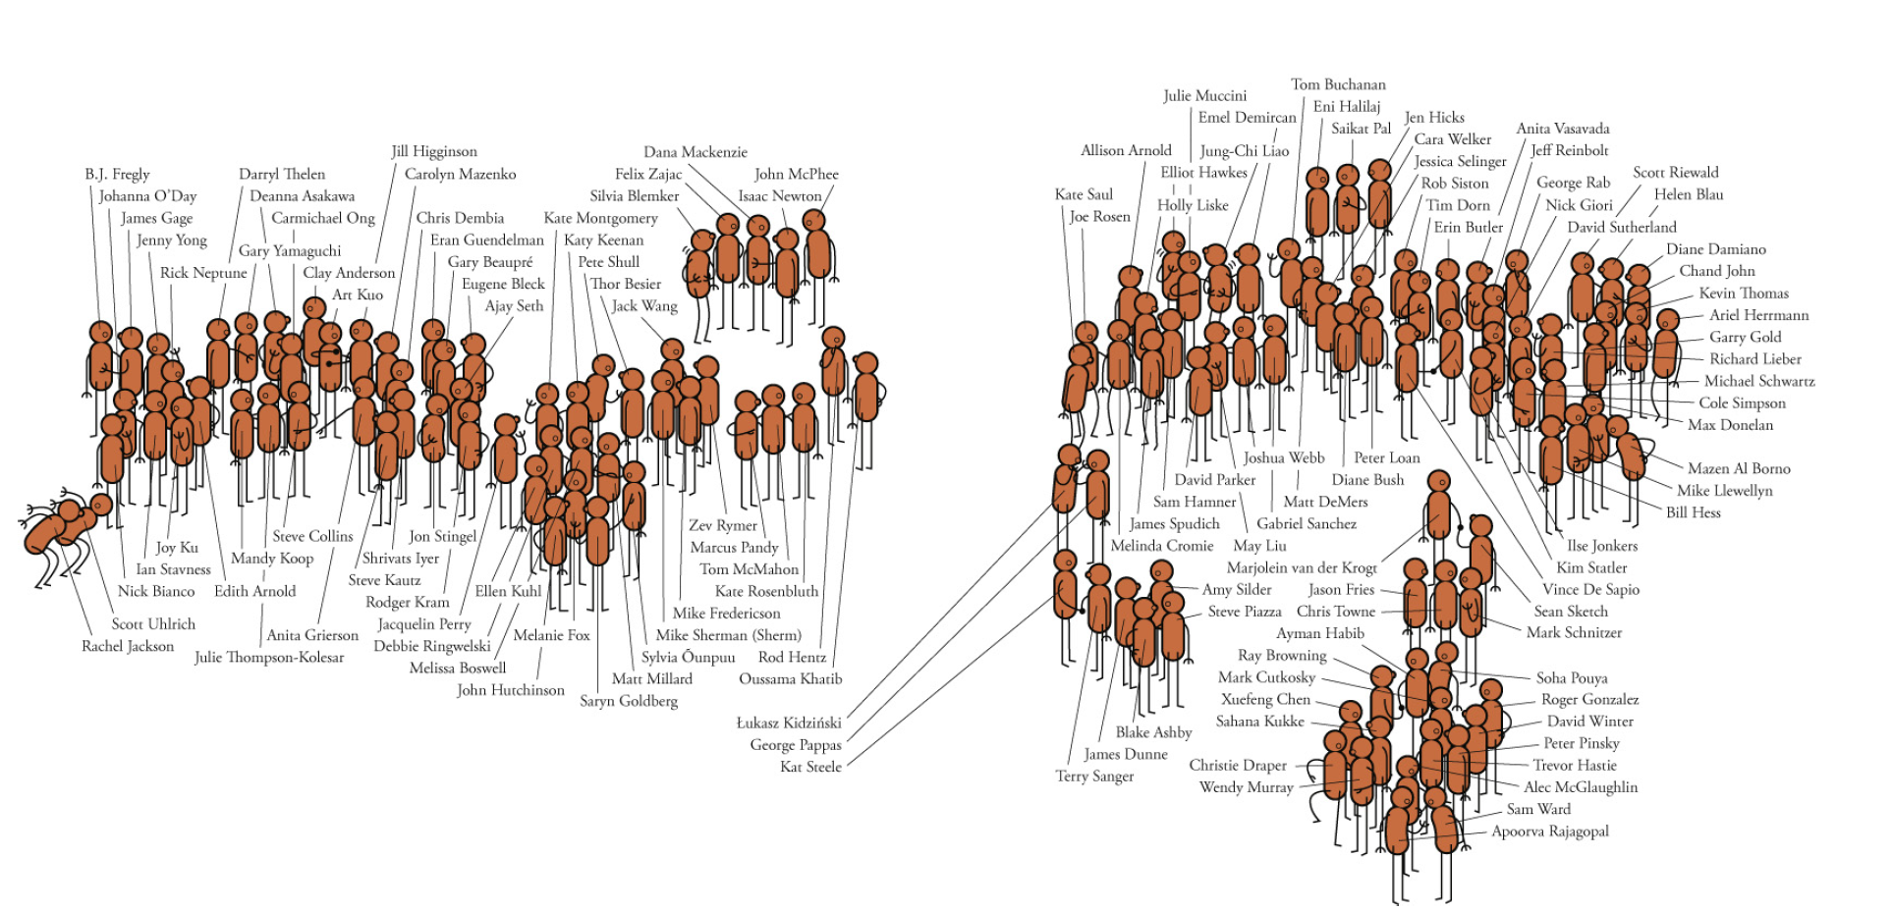

Slide 10
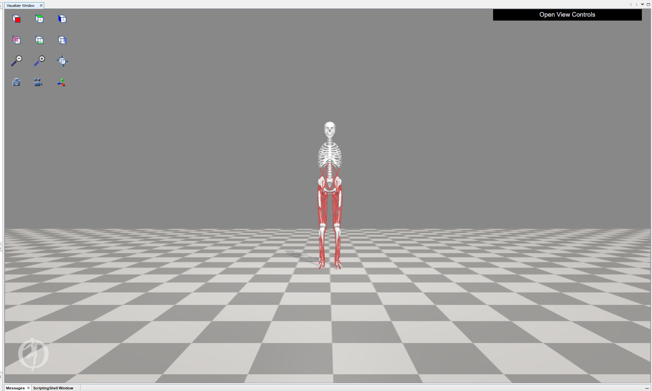

Slide 11
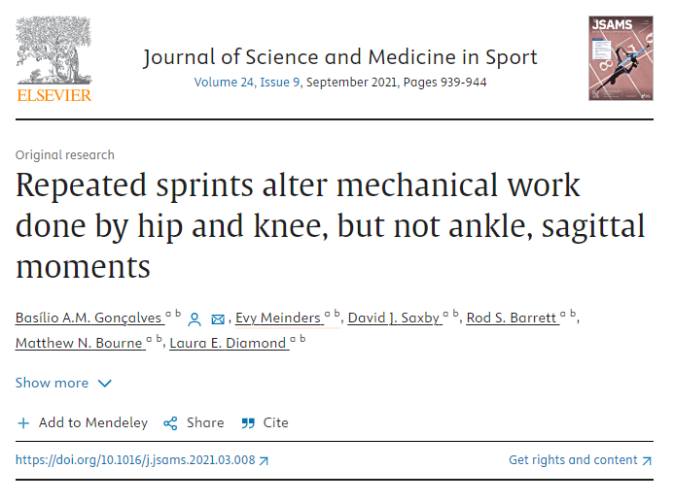
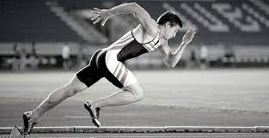
How has it been used?

Slide 12
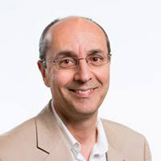
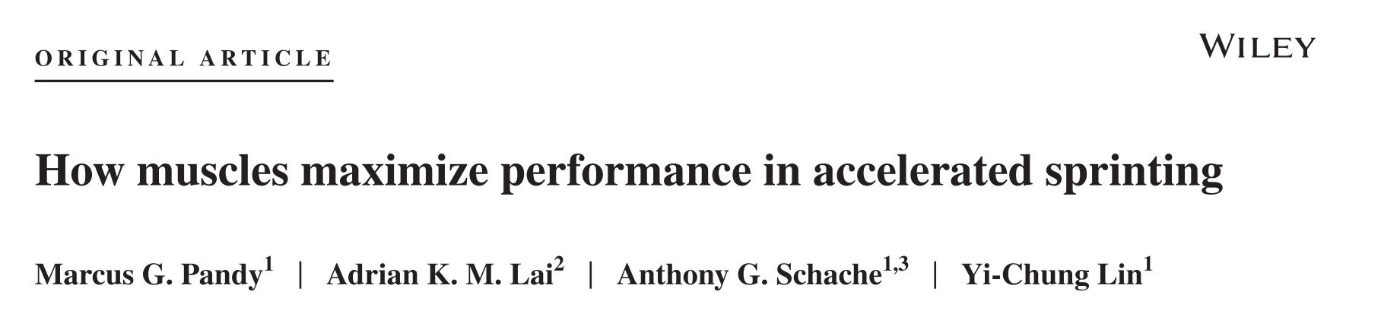
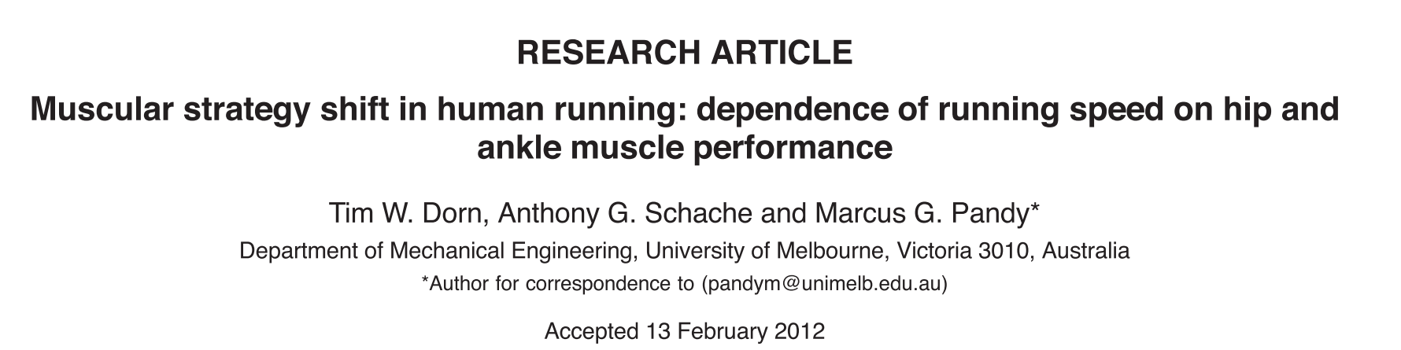
How has it been used?

Slide 13
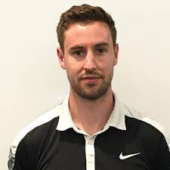
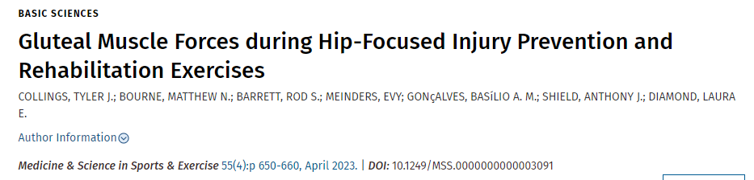
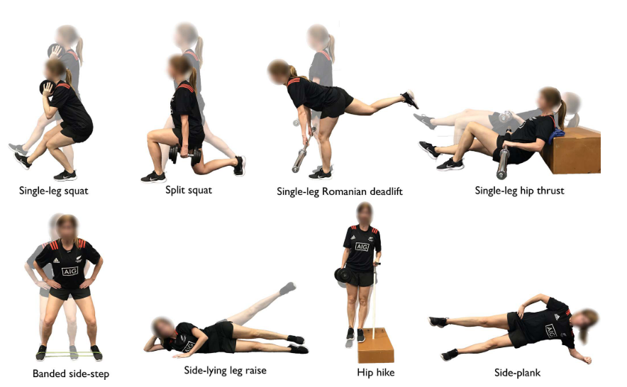
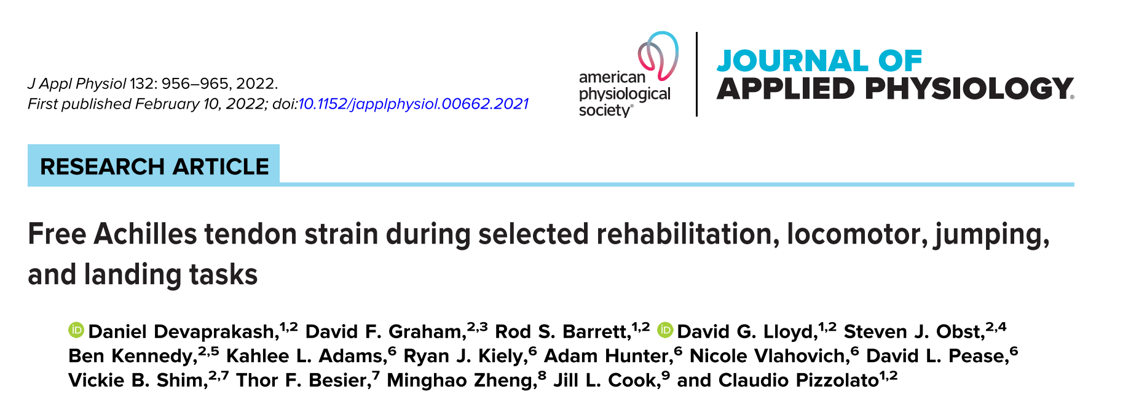
How has it been used?

Slide 14
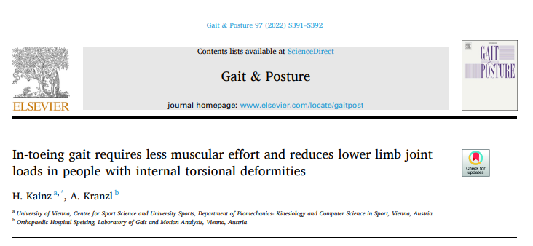
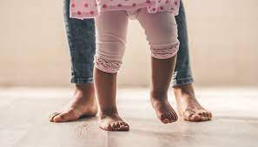
How has it been used?

Slide 15

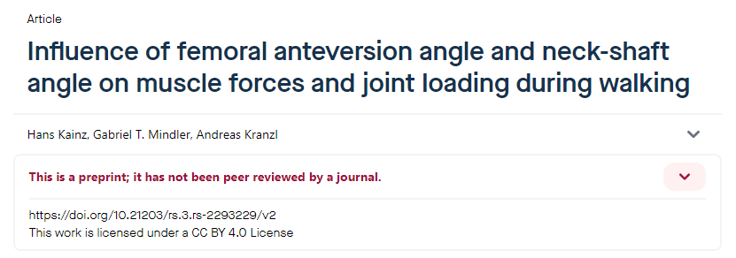
How has it been used?

Slide 16
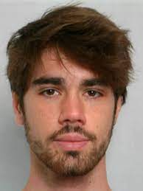
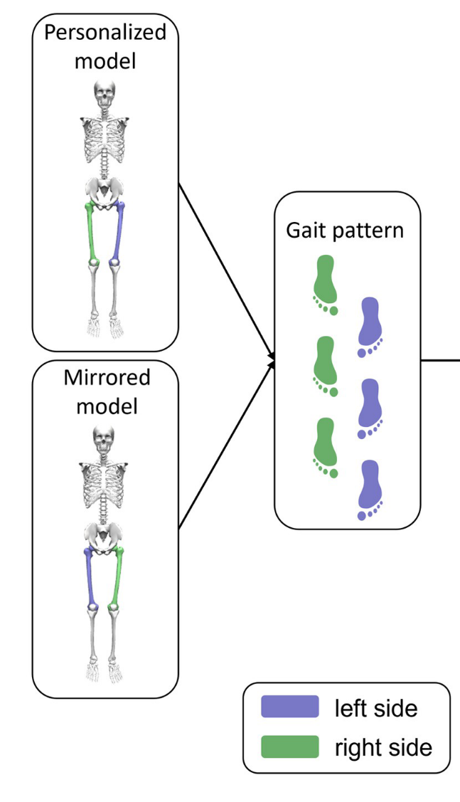
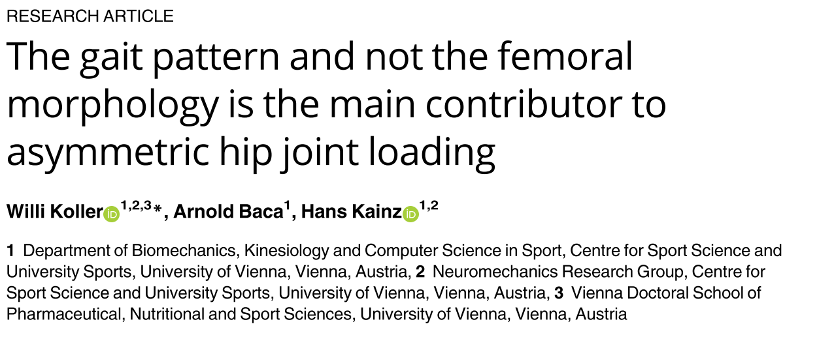
How has it been used?
Notes:
https://journals.plos.org/plosone/article?id=10.1371/journal.pone.0291789

Slide 17
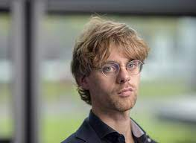

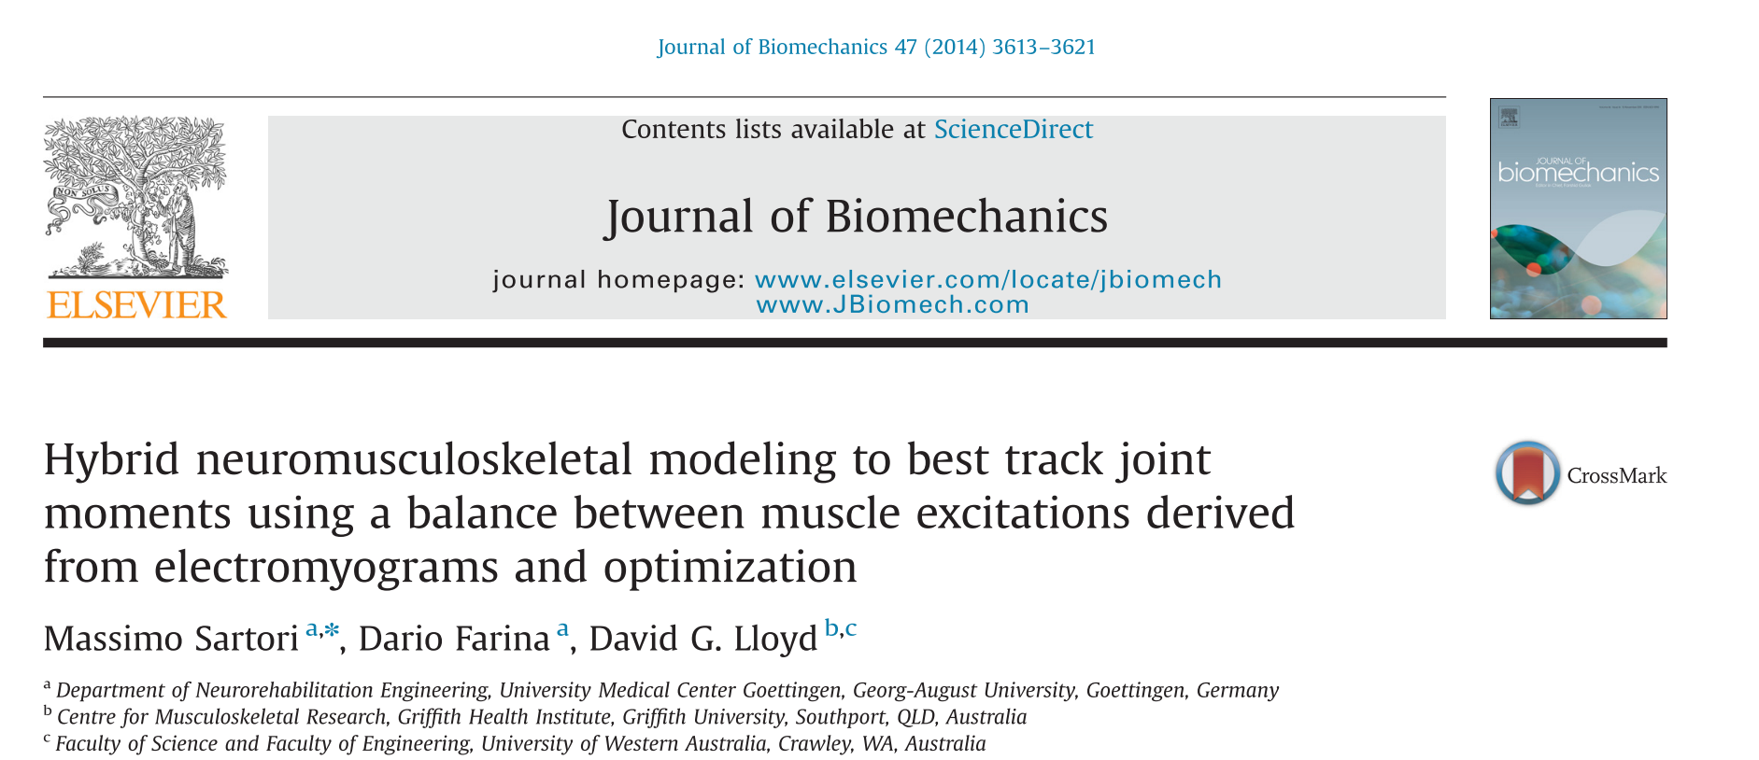
How has it been used?
Notes:
10.1016/j.jbiomech.2014.10.009

Slide 18
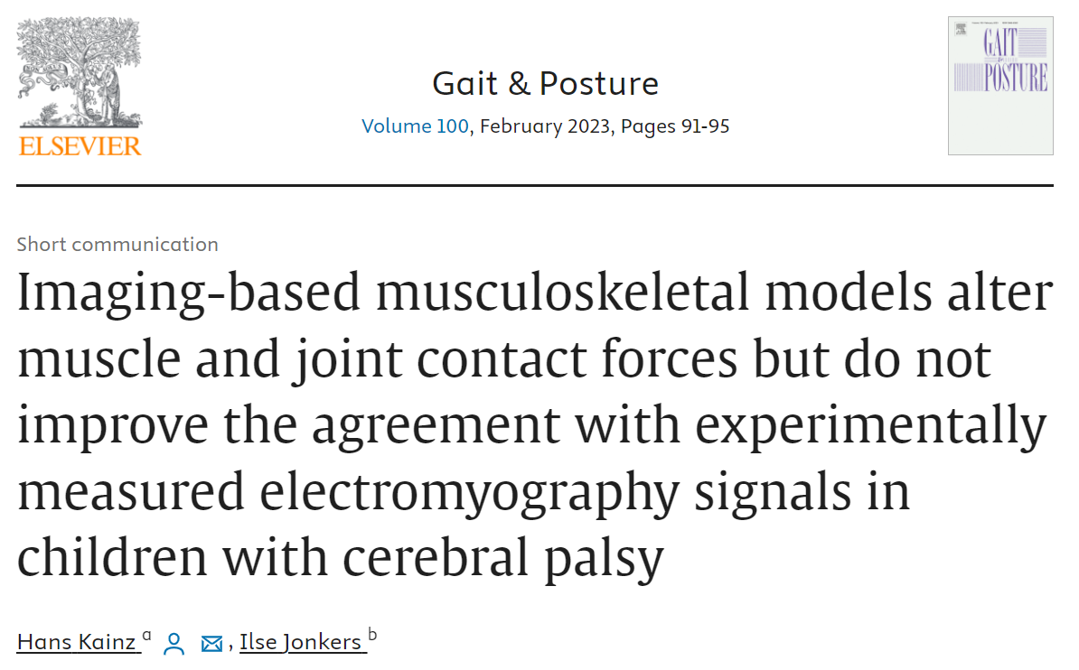
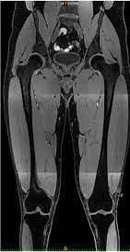
How has it been used?
Notes:
https://www.sciencedirect.com/science/article/abs/pii/S0966636222006567

Slide 19


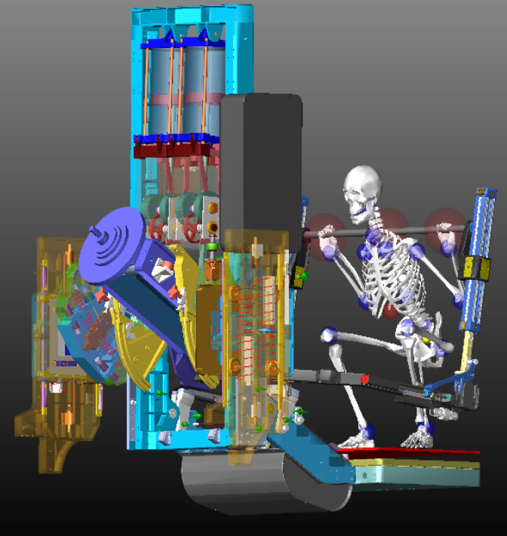
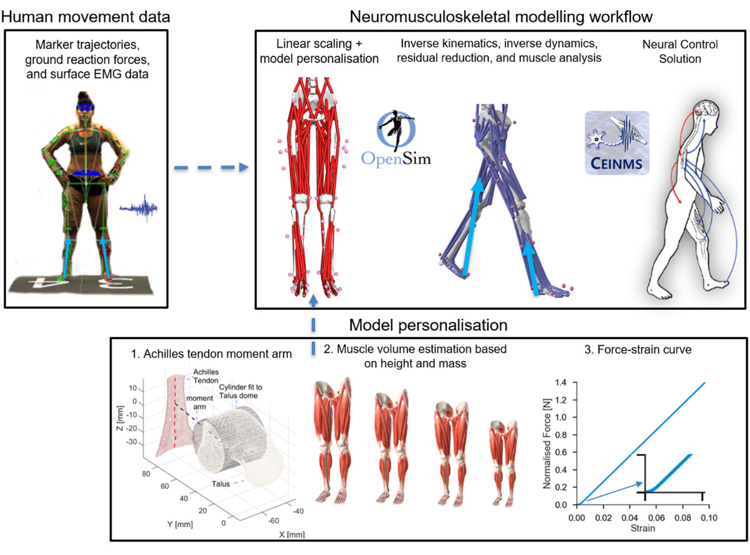
How has it been used?
Digital astronaut
Digital athlete
Notes:
https://www.nasa.gov/general/digital-astronaut-simulation-tool/
10.1152/japplphysiol.00662.2021

Slide 20
Modeling in opensim
Introduction to rigid body and muscle-tendon modelling;
The inverse problem
Model components
Input files
Available tools

Slide 21
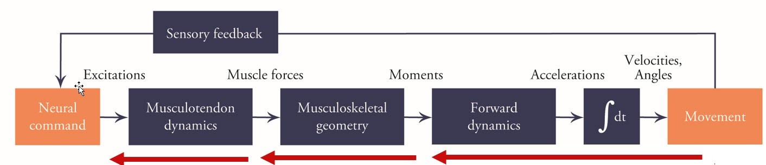
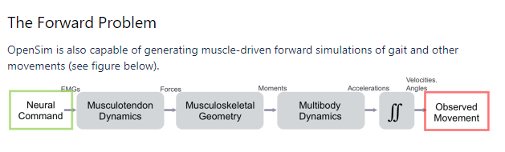
Inverse vs forward simulations
Introduction to rigid body and muscle-tendon modelling;

Slide 22
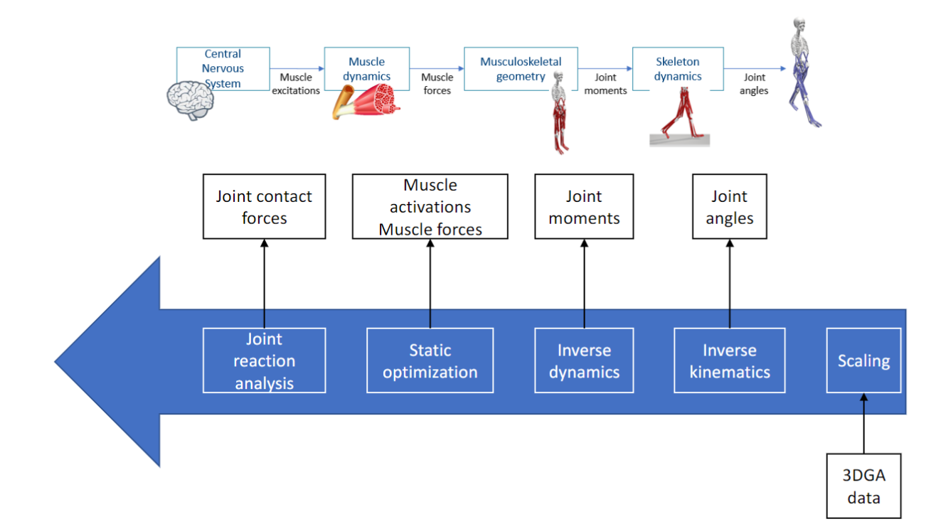
Inverse approach
Introduction to rigid body and muscle-tendon modelling;

Slide 23
What is a musculoskeletal model?
Introduction to rigid body and muscle-tendon modelling;
Rigid bodies
Connected by joints
Restricted by constrains
Actuated by muscles-tendon units
Informed by experimental data

Slide 24

Time to practice (use the folder “Hello_world_of_simulations”)
Introduction to rigid body and muscle-tendon modelling;
https://github.com/basgoncalves/BIP_OpenSim_Hungarian_USports

Slide 25
Questions
Introduction to rigid body and muscle-tendon modelling;
What are the components of a model?
How can a model be edited? (GUI, text editor, scripting)
How many bodies does this model have?
How many muscles does this model have in each leg?
What is the maximum isometric force of recfem?
How many DOF do the hip and knee joint have?
How heavy is the tibia segment?
Load experimental markers. Why are the markers doing a moon walk?
Load experimental GRF. Why are the forces not below the feet markers?

Slide 26
File types
Introduction to rigid body and muscle-tendon modelling;
.c3d - exported by most Gait Analysis laboratories
.trc – markers
.mot – motion files
.sto – storage files (results from analysis)
.xml – setup files
.osim – opensim models

Slide 27
Time to practice (practice plotting and explore files)
Introduction to rigid body and muscle-tendon modelling;
https://github.com/basgoncalves/BIP_OpenSim_Hungarian_USports

Slide 28
Questions
Introduction to rigid body and muscle-tendon modelling;
What is the maximum moment arm of psoas during hip_flexion_r?
Why are moment arms negative?
Plot the mtu lenght of the psoas_r during hip_flexion_r. Explain the figure.
Plot mtu length of lat_gas_r and bflh_r during hip flexion. Why are they so different?
Plot active, passive, and total-fiber force.

Slide 29
Break (10-15 min)
Introduction to rigid body and muscle-tendon modelling;

Slide 30
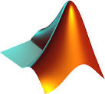

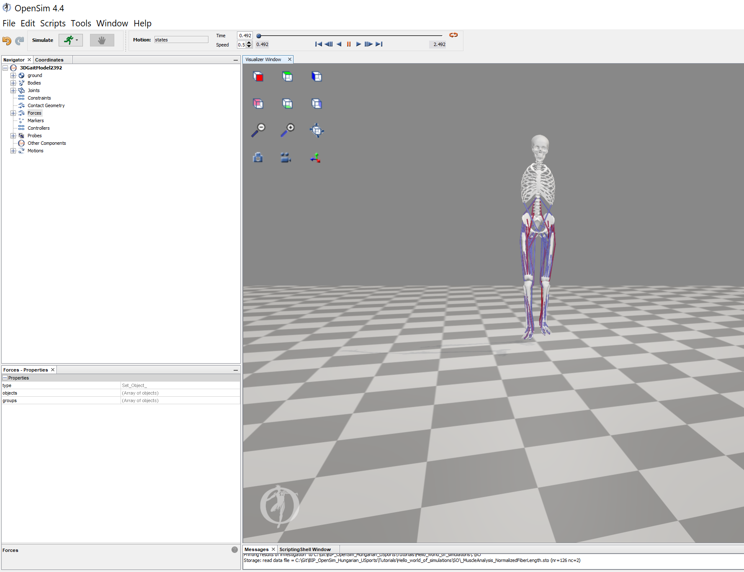
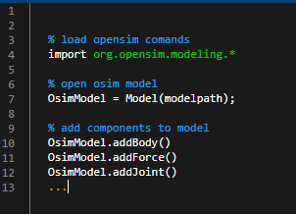
GUI vs CMD
Introduction to rigid body and muscle-tendon modelling;
C:\Users\Biomech\Documents\OpenSim\4.4\Code
https://simtk.org/api_docs/opensim/api_docs/

Slide 31
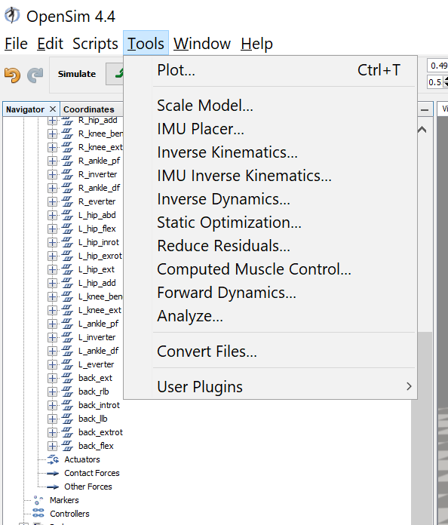
Run your first simulations

Slide 32
Time to practice (perform all analysis and plot results)
Introduction to rigid body and muscle-tendon modelling;
https://github.com/basgoncalves/BIP_OpenSim_Hungarian_USports

Slide 33
Questions
Introduction to rigid body and muscle-tendon modelling;
- What are the range of marker errors during the inverse kinematics step?
What are the peak hip, knee, and ankle angles?
What are the peak sagittal joint moments hip, knee, and ankle?
What are the lat_gas and rect_fem peak forces and activation?
What are the mtu lengths for bflh_r and soleus_r.
What are the maximum reserves moments hip_flexion_r, hip_adduction_r, hip_rotation_r, knee_angle_r, ankle_angle_r
How is the peak vertical component of hip contact loads, relative to participants body weight?

Slide 34
Musculoskeletal (MSK) modeling
Model personalization, Estimation of joint angles and external joint moments
Scaling
IK
ID

Slide 35
Time to practice (scale mode with wrong settings)
Introduction to rigid body and muscle-tendon modelling;
.\ExampleData\Bone_deformities\simulations\P01\pre\Static03

Slide 36
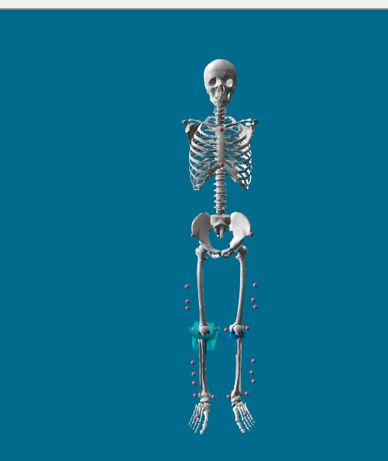
Scaling problems
Model personalization, Estimation of joint angles and external joint moments
Marker position
Marker weights
Check marker errors

Slide 37
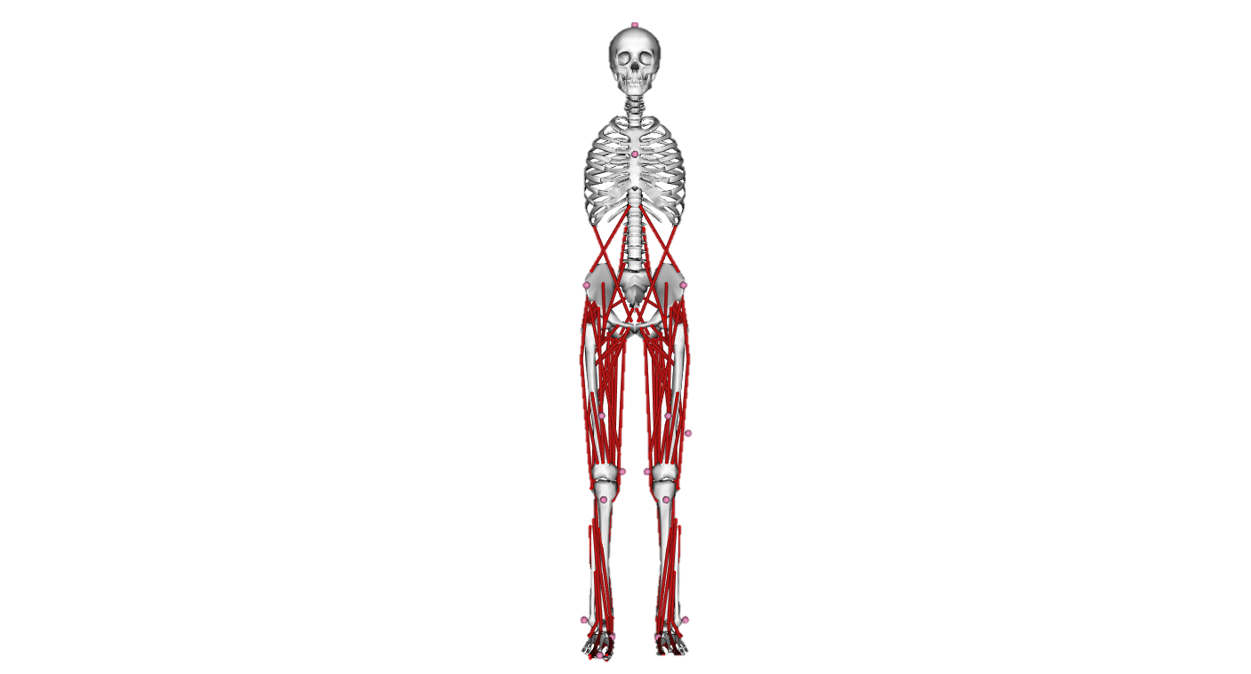


Why scaling?
Generic model

Slide 38
Why scaling?
Generic model

Slide 39
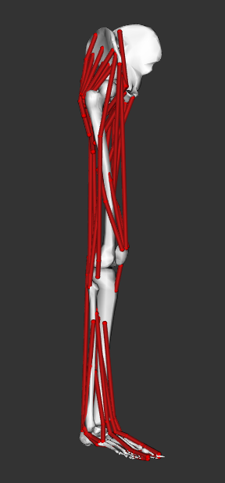
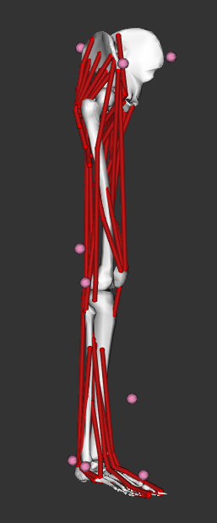

Scaling
Model + model markers
Experimental markers
Generic model

Slide 40


Definition of scale factors
Measurement-based scaling
Manual scaling
specified by the user based on some predetermined measure
e.g. anthropometric measurements
Generic model
Scaled model
Experimental markers
Model markers

Slide 41

Adjust model markers
adjusts the model markers to match the experimental markers at the static pose
Experimental markers
Model markers

Slide 42

Scaled model
Experimental markers
Model markers

Slide 43

Hints
Scaling can have a big impact on your simulation results
Use joint centers for scaling in participants with movement disorders

Slide 44


Direct Kinematics (DK)
Markers are rigidly attached to bones
Davis, 1988
Kadaba et al., 1989
Kadaba et al., 1990
Notes:
In Direct Kinematics it is assumed that the markers are rigidly attached to the bones. That means that it is assumed that no movements occur between the surface markers and the underlying bones. However, we know that this is not the case. If a person moves, soft tissue artefacts due to the movement of body segments and muscle contractions, change the position of the surface markers relative to the underlying bones.
The blue circles in this figure represent surface markers. The green circles represent joint centres which are also known as virtual markers.
Let’s assume that there is a lot of soft tissue artefacts at the shank segment and see what happens.

Slide 45
Direct Kinematics (DK)
Markers are rigidly attached to bones
Davis, 1988
Kadaba et al., 1989
Kadaba et al., 1990
Notes:
That’s a lot more soft tissue artefacts than in reality occurs but I want to show you what happens to the underlying skeletal model.

Slide 46
Direct Kinematics (DK)
Markers are rigidly attached to bones
Bone can change length
Davis, 1988
Kadaba et al., 1989
Kadaba et al., 1990
Notes:
Either it changes the segment lengths, in this case the shank segment.

Slide 47
Direct Kinematics (DK)
Markers are rigidly attached to bones
Bone can change length
Davis, 1988
Kadaba et al., 1989
Kadaba et al., 1990
Notes:
Or

Slide 48
Direct Kinematics (DK)
Markers are rigidly attached to bones
Bone can change length
Joints can fly apart
Davis, 1988
Kadaba et al., 1989
Kadaba et al., 1990
Notes:
It changes the position of the segment. That means the joints can fly apart. Neither, the change in bone length nor the change of the relative position of the segment is physiological correct. That’s one of the biggest drawbacks of Direct Kinematic approaches.

Slide 49

MSK modeling
Static calibration trial
Scaling
Scaled anatomical model
Dynamic walking trials
Inverse Kinematics
Joint angles
Inverse Dynamics
Joint moments
Muscle moment arms
Muscle-tendon lengths
Muscle forces, etc
Musculoskeletal analyses
Delp et al., 2007

Slide 50
Inverse kinematics (IK)
Experimental markers
Model markers
Notes:
Let’s play the same game as before and assume we have a participant with a lot of soft tissue and the markers are moving relative to the underlying bone. On the first picture here we can see the perfect case. All the model markers perfectly match the experimental markers. That’s the reason why we only see the model markers on this figure. The experimental markers are underneath the red model markers.

Slide 51
Inverse kinematics (IK)
Experimental markers
Model markers
Notes:
Let’s assume the experimental markers of the shank segment are a lot more distal compared to the model markers of the shank. Same initial situation as we had before when we were looking at the Direct Kinematics approach.

Slide 52
Inverse kinematics (IK)
Markers are NOT rigidly attached to bones
Fixed bone length
Constrained joint movements
Experimental markers
Model markers
Notes:
Inverse Kinematics changes the pose of the model, without changing the segment lengths or allowing the joints to fly apart, to match the position of the experimental markers as good as possible.
Let’s summarize the Inverse Kinematics approach again:
It is NOT assumed that the markers are rigidly attached to the bones but we have a rigid generic model, which does not allow changes in bone lengths after scaling. Furthermore, joint movements are constrained which prevents un-physiological joint movements.

Slide 53
Time to practice (IK with wrong weights)
Introduction to rigid body and muscle-tendon modelling;
.\ExampleData\Bone_deformities\simulations\P01\pre\dynamic04_l

Slide 54
Time to practice (IK with wrong weights )
Introduction to rigid body and muscle-tendon modelling;
.\ExampleData\Bone_deformities\simulations\P01\pre\Static03

Slide 55

Torque (τ)/Moment (M)
Introduction to rigid body and muscle-tendon modelling;
The tendency of a load to produce a rotation (not a translation!)
τ or M is the cross product of the
Applied force (F)
Moment arm (r): shortest distance between the line of force and the axis of rotation
M = F × r

Slide 56

Torque (τ)/Moment (M)
Introduction to rigid body and muscle-tendon modelling;

Slide 57
Time to practice (prepare the GRF files)
Introduction to rigid body and muscle-tendon modelling;
.\ExampleData\Bone_deformities\simulations\P01\pre\dynamic04_l

Slide 58
Questions
Introduction to rigid body and muscle-tendon modelling;

Slide 59
Muscle forces in openSim
Estimation of muscle and joint contact forces
Garbage in garbage out
Check the inputs
Moment arm

Slide 60

Forces / muscle mechanics
Optimal fibre length
Tendon slack length
Maximum isometric force
Pennation angle at optimal fibre length
Maximum contraction velocity

Slide 61

Muscle moment arms
Estimation of muscle and joint contact forces

Slide 62
Muscle moment arms
Estimation of muscle and joint contact forces

Slide 63
Theroy muscle and static opt
Estimation of muscle and joint contact forces

Slide 64
Time to practice (static optimisation)
Introduction to rigid body and muscle-tendon modelling;
.\ExampleData\Bone_deformities\simulations\P01\pre\dynamic04_l

Slide 65
Questions about the muscle forces
Estimation of muscle and joint contact forces

Slide 66

Calculations joint contact forces
Estimation of muscle and joint contact forces
Parent or child
Body orientations

Slide 67
Effects of surgery transfer
Simulate the effects of musculoskeletal alterations on muscle and joint loads
#

Slide 68
Muscle and joint loading during running
Simulate the effects of musculoskeletal alterations on muscle and joint loads
#

Slide 69
Effects of bone geometry on joint loading
Simulate the effects of musculoskeletal alterations on muscle and joint loads
TD01 and P01

Slide 70
Musculoskeletal (MSK) modeling
Summary and future directions
Data collection
Traditional gait analysis
Advantages of MSK modeling
What is a MSK model?

Slide 71
Musculoskeletal (MSK) modeling
Summary and future directions
Data collection
Traditional gait analysis
Advantages of MSK modeling
What is a MSK model?

